Slide 1

Analysis and forecast of the Earth Surface temperature
Time series and forecasting
José pedro gama de sousa rodigues
202006455
Notes:
Good morning, my name is José Pedro Rodrigues, and my project is called Analysis and forecast of the Earth Surface Temperature.

Slide 2


Pre-Analysis
CSV: “GlobalTemperatures.csv”
Python with jupyter Notebook as IDE
Pandas, Numpy, Matplot, Seaborn, Statsmodels and Sklearn
Pre-processing of Data
Handling Missing Values
Drop redundant columns
Drop uncertain rows
Notes:
The time series my project is based on is from a csv in kaggle called “GlobalTemperatures.csv”. The project was done using python in jupyter notebook, with the 6 main libraries used being: Pandas, Numpy, Matplot Seaborn, Sklearn and Statsmodel, which was the main focus due to being responsible for the EDA and forecasting Models.
Some pre-processing of the data was also done. This was mainly dropping redundant columns and Handling missing values. The original CSV had 9 columns with data being from 1975 to 2015, after pre-processing the data was only 2 columns (Date and LandTemperatureAverage) and consisted of data that was only from 1985 to 2015.

Slide 3
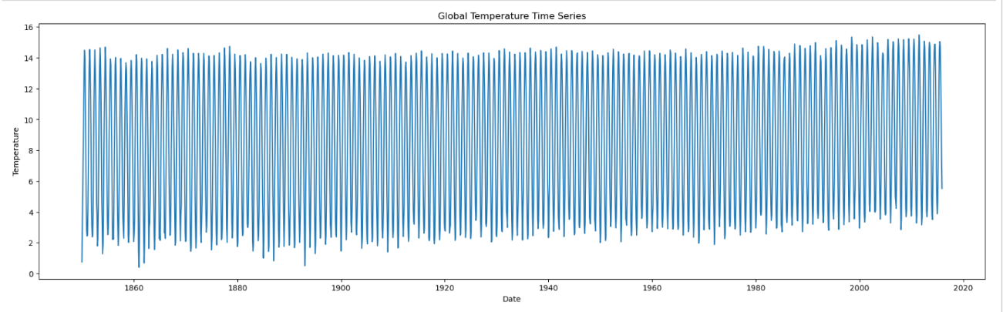
Explaratory Data Analysis
Strong seasonality
Slight trend
Notes:
My EDA process begun with the visualization of the data. After plotting the time series my initial suspicions were of strong seasonality and maybe a slight trend but further analysis needed to be done.

Slide 4
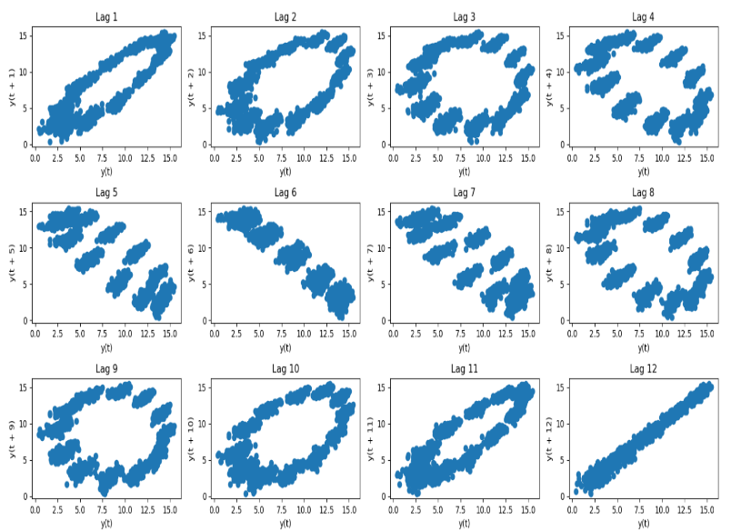
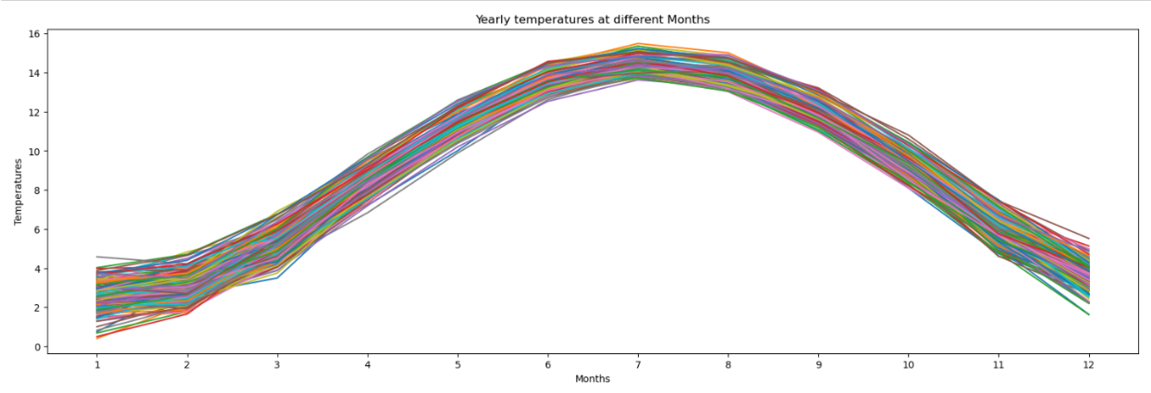
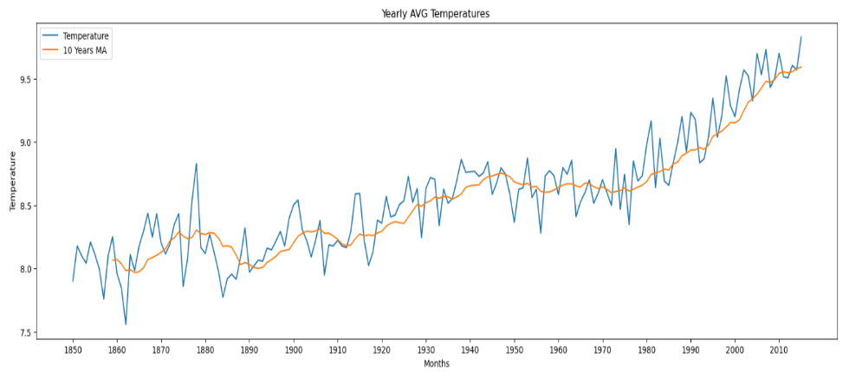
Lag plot indicates yearly Seasonality
July and August had the highest temperatures
Yearly average temperatures indicate trend
Notes:
The first step of that process was made with the creation of 3 different plots. The first one was yearly temperatures at different months: this plot showed that the different years behaved similarly, indicating seasonality. The second plot indicated average land temperature over the years, this plot clearly showed an increase in trend. And lastly a lag plot that indicated yearly seasonality, as you can see in Lag 12.

Slide 5
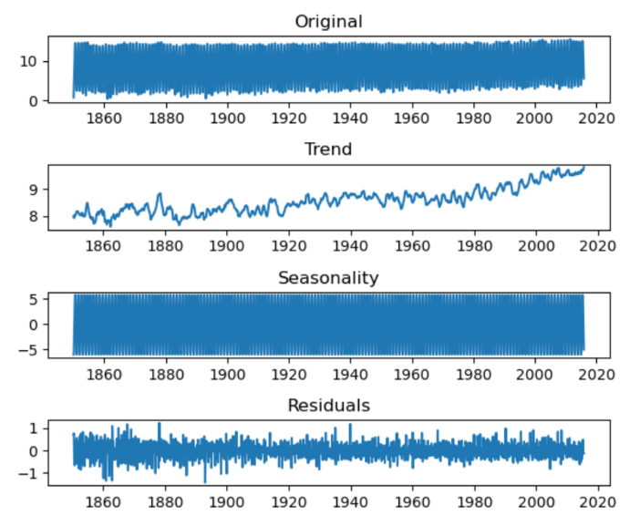
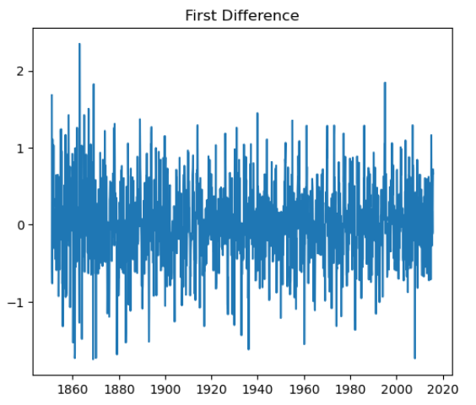
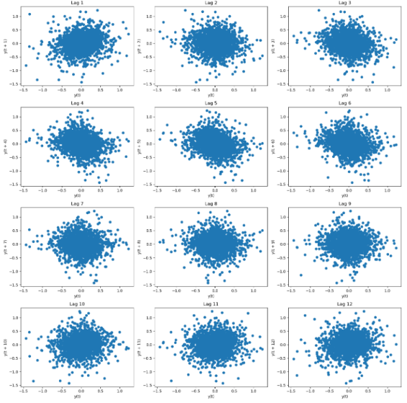
Methods of Decomposition
Differencing Operator (∇S=1−B¹²)
TS Decomposition
Notes:
For further analysis 2 methods of decomposition were performed. The first one was using a function in python with the same function as decompose in R. This divided the original Time Series in 4 plots. Original, Trend, Seasonality and residuals. A lag plot was then mad using these residuals, which as suspected showed no trend or seasonality.
The other method of decomposition that was used was a seasonal difference operator, and plotting the residuals. A Non-seasonal difference was also investigated but was dropped due to the suspicion of over differencing, since it could lead to misleading results.

Slide 6
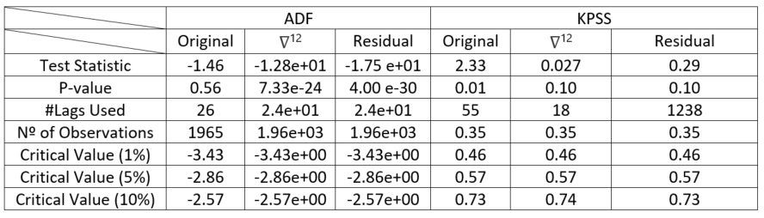
ADF & KPSS
Original: Unable to Reject ADF H₀ ; Rejects KPSS H₀
Differenece operator: Rejects ADF H₀; Does not reject KPSS H₀
Residual: Rejects ADF H₀; Does not reject KPSS H₀
Notes:
Stationarity was then confirmed using the ADF and KPSS tests. Analysing table.1 the original timeseries fails to reject the null hypothesis of the ADF and rejects the null hypothesis of the KPSS by having a p-value lower than 0.5 and a test Statistic higher than the critical values, meaning that the original time series is not stationary. On the other hand, Both the residual of the seasonal_decompose and the seasonal difference operator have an ADF test statistic lower than the critical value and the p-value extremely small. On the KPSS the null hypothesis was not rejected meaning that both are considered stationary.

Slide 7
Forecasting
Notes:
The Forecasting of this time series was done using different methods: The first onne was using different SARIMA models, the second was using the two variations of Exponential smoothing:additive and multiplicative. The final was using cross-validation on all the different models and check for differences.

Slide 8
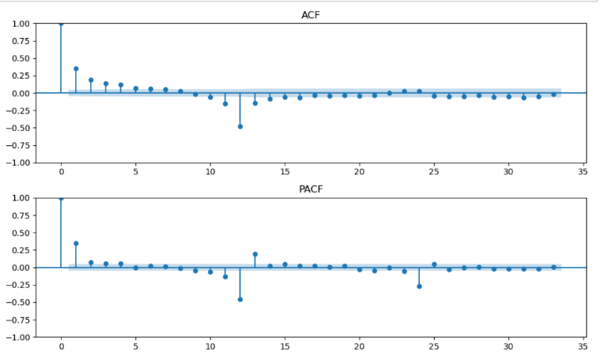
SARIMA
3 Models through the analysis of ACF and PACF:
(2,0,0)(0,1,1)12
(3,0,0)(0,1,1)12
(0,0,2)(0,1,1)12
2 Models using auto.arima:
(0,0,10)(0,1,3)12
(0,0,3)(2,1,3)12
ACF Non-seasonal decay; Spike at Lag 12
PACF Seasonal Decay, Inital spike at Lag 2
Notes:
The first step in the modelling of the data was dividing it into train and test data. I used the data up to 2010 as train and the rest as test. Then I used the residuals of the seasonal difference operator and plotted the ACF and PACF. The ACF showed slight decay and a large spike at lag 12. The PACF showed slight seasonal decay and a spike at lag 2. This made me consider three models (2,0,0)(0,1,1)12,(3,0,0)(0,1,1)12 and (0,0,2)(0,1,1)12 to consider other options. The last 2 models were calculated using auto.arima.

Slide 9
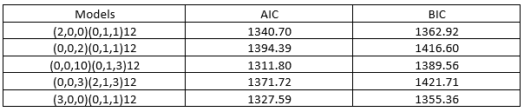
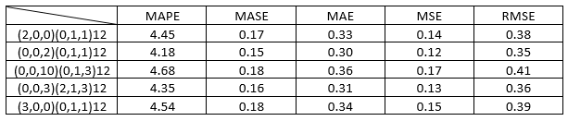
Evaluation
Model with lowest AIC was model 3
Model with lowest BIC was model 5
Model 4 had the lowest error values in most of the error measures
Near identical results
Notes:
To evaluate these models I compared the AIC and BIC values and calculated the errors. Model 3 had the lowest AIC value and model 5 had the lowest BIC. In terms of the errors table Model 4 had the lowest errors in most of the measures but the results were near identical.

Slide 10
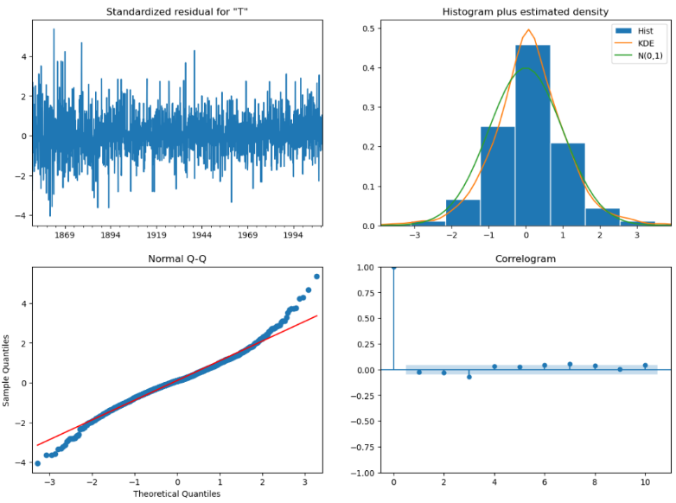
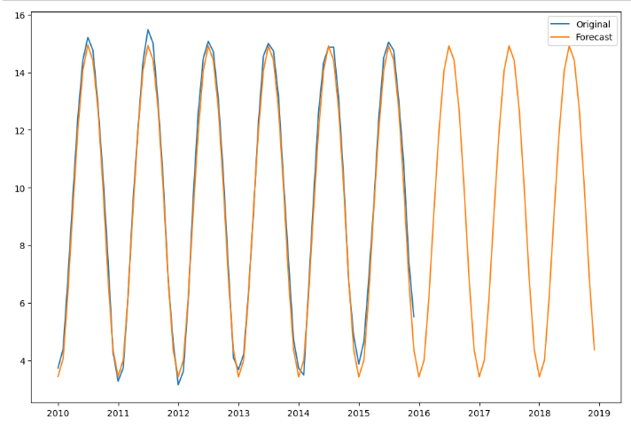
Diagnostics and out of-point forecasting of SARIMA (3,0,0)(0,1,1)12
No obvious patterns in residuals, The QQ plot shows that most of the points lie on the straight line, lastly 95% of residuals in the correlogram (ACF of residuals) are within the confidence band
Notes:
Looking at the diagnostocs of this specific model. The qq plot showed that most of the points lied on the straight line and the ACF of the residuals showed that the residuals were uncorrelated by being within the confidence band, Indicating a good model. The out of point forecasting plot also showed this since the forecast had very similar results to the original.

Slide 11

Exponential Smoothing
Two variations: Additive and Multiplicative
The method with the lowest error metrics was the multiplicative method. This is not surprising since the decomposition of the time series showed an added trend to the strong seasonality, although the distinction of methods was almost inconsequential.
Notes:
For a time series that contains a trend and seasonality the use of the Holt-Winter method was recommended. This method has two variations: Additive and Multiplicative. The additive method being preferred when the seasonal variations are constant through the series and the multiplicative method being preferred when a time series has seasonality and trend. The errors table showed that the method with the lowest error metrics was the multiplicative. This is not surprising since the decomposition of the time series showed an added trend to the strong seasonality, although the distinction of methods was almost inconsequential.

Slide 12
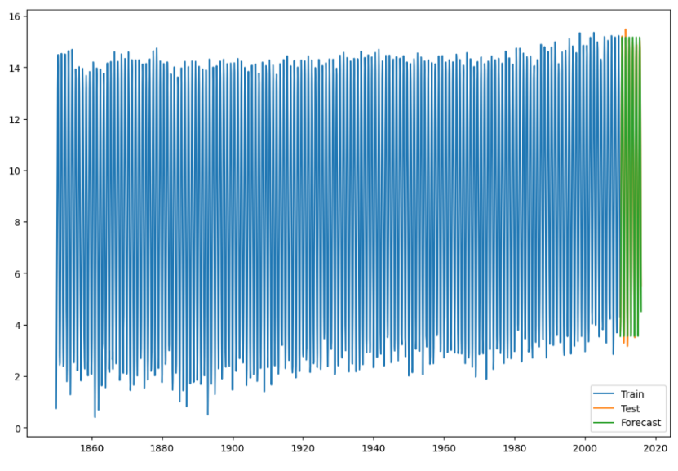
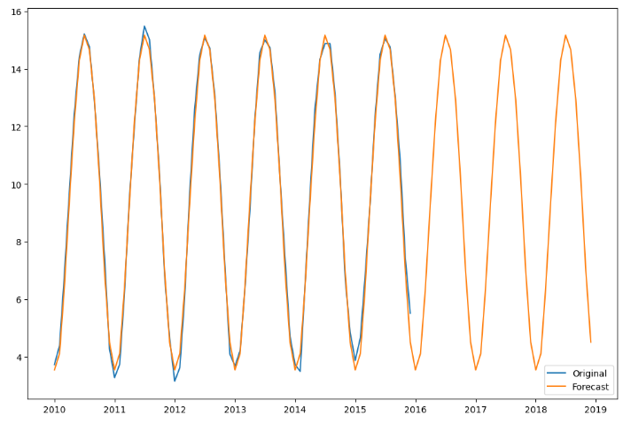
In-Point Forecasting
Out of Point Forecasting
Notes:
The out of point forecasting shows a lightly more accurate plot than the ones made with the SARIMA models this was also seen in the error table that showed slightly lower values.

Slide 13
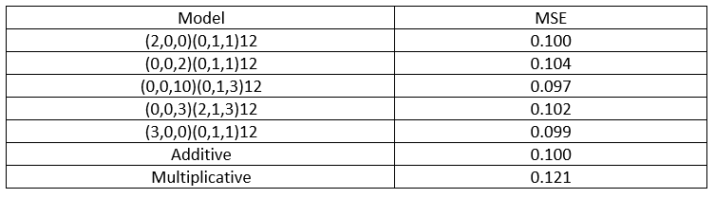
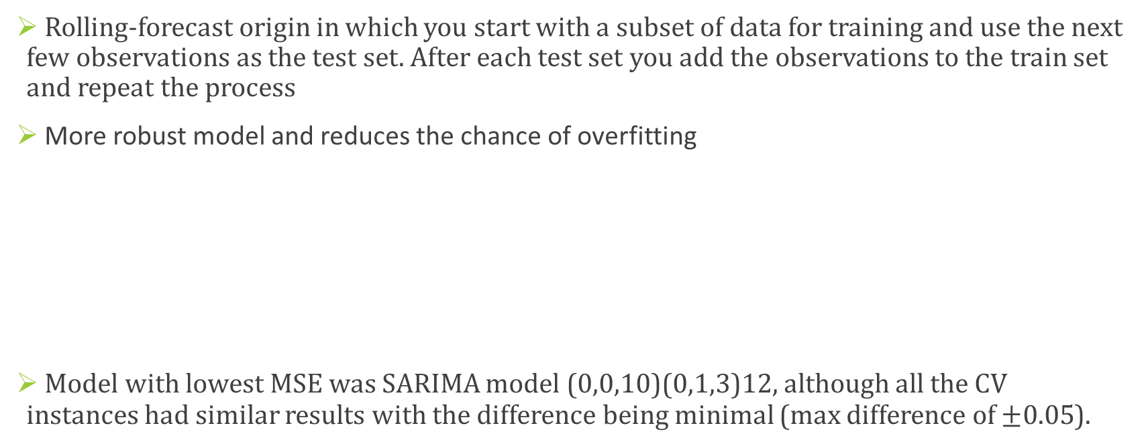
Cross-Validation
Rolling-forecast origin in which you start with a subset of data for training and use the next few observations as the test set. After each test set you add the observations to the train set and repeat the process
More robust model and reduces the chance of overfitting
Model with lowest MSE was SARIMA model (0,0,10)(0,1,3)12, although all the CV instances had similar results with the difference being minimal (max difference of $±0.05$).
Notes:
Finally, a cross-validation to the time series was done to all the models. This was done with the purpose of creating a more robust model and to prevent overfitting. The model with lowest MSE was SARIMA model (0,0,10)(0,1,3)12, although all the CV instances had similar results with the difference being minimal

Slide 14
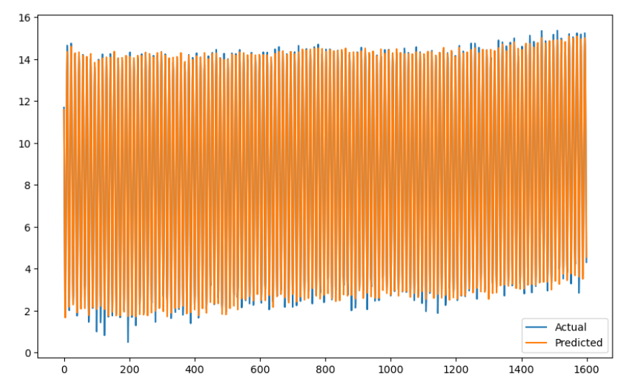
Forecasting using Cross-validation with SARIMA model (3,0,0)(0,1,1)12
Notes:
This is the forecasting plot of the sarima model that was previously shown.

Slide 15
Conclusion
EDA showed strong yearly seasonality and a slight upward trend
Forecasting methods utilized showed similar results, which after evaluating each model the results showed high accuracy with low error values
The SARIMA model (3,0,0)(0,1,1)12 was considered the best performing of the SARIMA models since it had the lowest BIC combined with being in the lower-end of the spectrum in terms of errors
The exponential smoothing forecasting showed slightly smaller MSE values than the SARIMA models, with the best performing model using the multiplicative method
CV gave contradictory results since although the Cross-validation of the SARIMA models gave slightly lower errors, the CV in exponential smoothing had no affect or in the more specific case of multiplicative ES gave higher errors.
Notes:
In conclusion, the EDA showed strong yearly seasonality and a slight upward trend, the forecasting methods utilized showed similar results, which after evaluating each model the results showed high accuracy with low error values. The exponential smoothing forecasting showed slightly smaller MSE values than the SARIMA models, with the best performing model using the multiplicative method. CV gave contradictory results since although the Cross-validation of the SARIMA models gave slightly lower errors, the CV in exponential smoothing had no affect or in the more specific case of multiplicative ES gave higher errors.

